Slide 1
DETECTION OF COVID-19 USING DEEP LEARNING

Slide 2
Contents
Abstract
Introduction
Dataset
Data preparation, preprocessing and augmentation
Transfer Learning
DenseNet201
ResNet152
Pseudo code
Results
Conclusion

Slide 3
Abstract
The world health organization states that the coronavirus epidemic has created a daily threat to the global healthcare system. After numerous deaths around the world, pandemic unlocked a new threat making people ready for something which is similar and unpredictable. So, Correct detection of disease is crucial in surviving the pandemic. For that, we proposed a deep-learning-based approach for the detection of COVID-19 from X-ray and CT-scan images using CNN architectures such as DenseNet201 and ResNet152.

Slide 4
Introduction
Coronavirus was first discovered in China, in December 2019. In March 2020, the World Health Organization identified COVID-19 as a pandemic. It is a respiratory illness caused by the SARS-CoV-2 virus, which primarily affects the lungs.
X-ray and CT-scan images are helpful for the detection of COVID-19 because they can provide a visual representation of the infection in the lungs.
By reviewing some papers we observed that Deep Learning Techniques stood out in performance from other models.

Slide 5
Dataset
Type | No. of Samples | No. of Patients
X-RAY(Train) | COVID-19 : 3616 | 130
 | Non-COVID-19 : 7200 | 240
X-RAY(Test) | COVID-19 : 111 | 111
 | Non-COVID-19 : 230 | 230
CT Scan | COVID-19 : 12231 | 165
 | Non-COVID-19 : 2251 | 28
The CT Scan dataset is divided in the ratio of 80:20 where 20% of data is used for testing the model and 80% of data is used for training the model.
Above Dataset is obtained from Qatar University.

Slide 6
Data Preparation
Usually, characteristics of the images were different since the images were collected from different local diagnostic centers with dissimilar radiology equipment.
To address this issue, first, it is converted to a single gray channel space (grayscale).
X-ray images and CT scan images were resized to sizes 224, 224 for standard model input.

Slide 7
Data Preprocessing and Augmentation
One of the most important steps of preprocessing is data normalization, which plays a vital role not only in image convergence speed but also in increasing training speed.
For this purpose, we rescale the images, where our original image consist in RGB coefficients in 0-255 which is high for our model to process.
So we convert the images by rescaling the values in between 0-1 by using the formula 1./255
Since CNN networks are data-driven, as the amount of data increases, the efficiency of these processing units improves due to the maximum coverage of the feature space.

Slide 8
Data Preprocessing and Augmentation
At augmentation stage, data were added to the train dataset using the methods of vertical flip, horizontal flip, and rotation range.
This augmentation was done in such a way that those images that are most similar to the original images and images that are not like noise for the model are produced.
Before feeding the data to the networks, all the images of the dataset were shuffled.
so that the network does not necessarily see the data of a particular class during each iteration, and in fact, each category contains images with different tags from both classes of COVID-19 and non-COVID-19 cases.

Slide 9
Transfer Learning
Constructing deep learning models from scratch is a time consuming, complex process that needs a lot of data, which can easily avoidable via transfer learning.
Transfer Learning is particularly popular in deep learning.
Transfer learning is the method of starting with a pre-trained model and training it for a new related problem domain.
Here, We fine-tuned two pre-trained models DenseNet201 and ResNet152 that had been trained on a very large dataset called ImageNet.

Slide 10
DenseNet201 model
DenseNet is densely connected-convolutional networks and it takes all previous output as an input for a future layers.
A DenseNet variant called DenseNet201 contains 201 layers.
Better feature reuse is possible as it is made up of a number of dense blocks.
Each dense block performs feature extraction by the convolutional layers, batch normalization and ReLu activation functions as well as pooling and transition layers which performs the feature maps spatial dimensions and its final output passed to further dense blocks.
Finally, global average pooling layer, a fully connected layer, and a softmax activation function is used for classification.

Slide 11
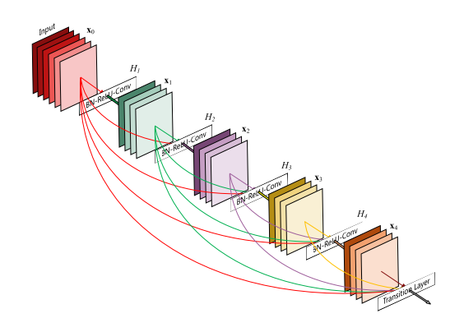
DenseNet Architecture

Slide 12
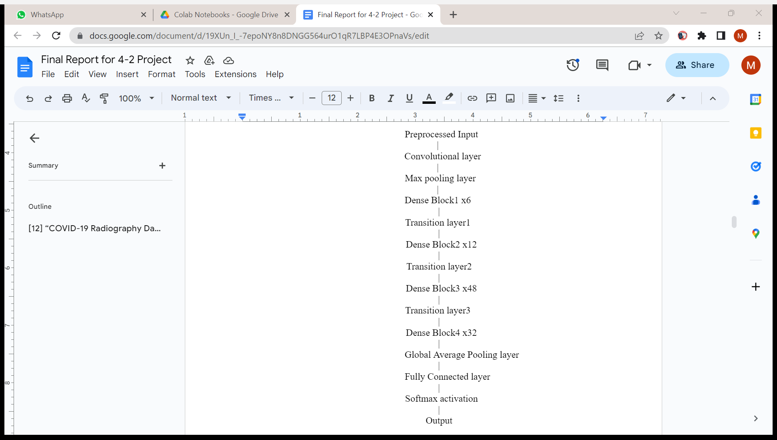
DenseNet201 Architecture

Slide 13
ResNet152 model
The ResNet architecture was designed by incorporating skip connections to address the problem of vanishing gradients in deep neural networks, which can occur when the network is too deep.
The skip connection connects activations of a layer to further layers by skipping some layers in between.
The advantage of adding this type of skip connection is that if any layer hurt the performance of architecture then it will be skipped by regularization.
The ResNet152 model is a very deep neural network that consists of 152 layers. It has a similar basic structure to other ResNet models, with a stack of residual blocks consists of layers for feature extraction.

Slide 14
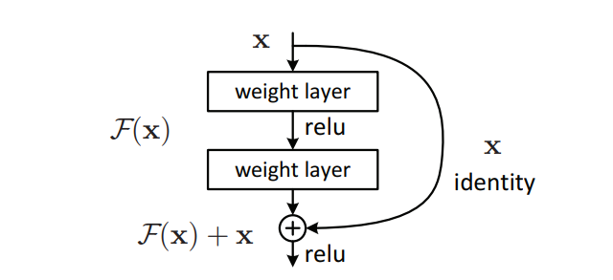
Skip Connection

Slide 15
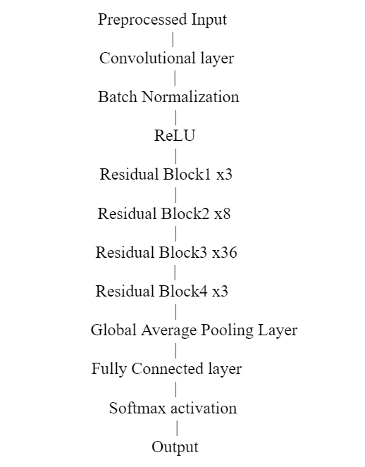
ResNet152 architecture

Slide 16
Pseudo code
Input: Input image (From both X-ray and CT-scan datasets)
Output: Performance evaluation and random testing by giving images i.e.; Detecting whether it is COVID-19 or Non- COVID19.
Begin
Performed Data Pre-processing
Performed Data augmentation i.e.; (Horizontal Flip, Vertical Flip, Rotating)
Apply pre-trained models i.e.; (DenseNet201, ResNet152) Pre-trained model = training((Input images, Labels))
Pre-trained model = testing (Input images) Performance=Confusion_matrix(Predicted, Actual)
End

Slide 17
Results
After applying DenseNet201 and ResNet152 models on both X-Ray and CT-Scan datasets, the obtained accuracies are shown in below Table. We noticed that ResNet152 performed more accurately on both datasets by observing the below differences.
Model | X-Ray dataset Accuracies | CT-Scan dataset Accuracies
DenseNet201 | 92.96 | 97.52
ResNet152 | 98.83 | 99.08

Slide 18
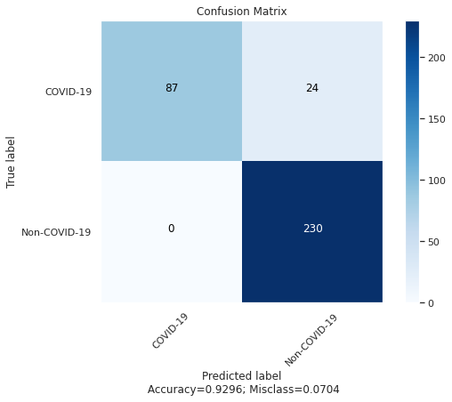
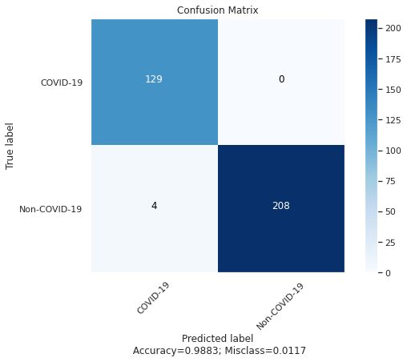
Below are the Confusion Matrices after applying DenseNet201 and ResNet152 models on X-Ray Dataset.

Slide 19
Below are the performance metrics after applying DenseNet201 and ResNet152 models on X-Ray Dataset.
Metrics | DenseNet201 | ResNet152
MAE | 0.07038123167155426 | 0.011730205278592375
Accuracy | [0.92961877 0.92961877] | [0.98826979 0.98826979]
Precision | [1. 0.90551181] | [0.96992481 1. ]
Recall | [0.78378378 1. ] | [1. 0.98113208]
Specificity | [1. 0.78378378] | [0.98113208 1. ]
Negative Predictive Value | [0.90551181 1. ] | [1. 0.96992481]
Fall out | [0. 0.21621622] | [0.01886792 0. ]
False Negative Rate | [0.21621622 0. ] | [0. 0.01886792]
False Discovery Rate | [0. 0.09448819] | [0.03007519 0. ]

Slide 20
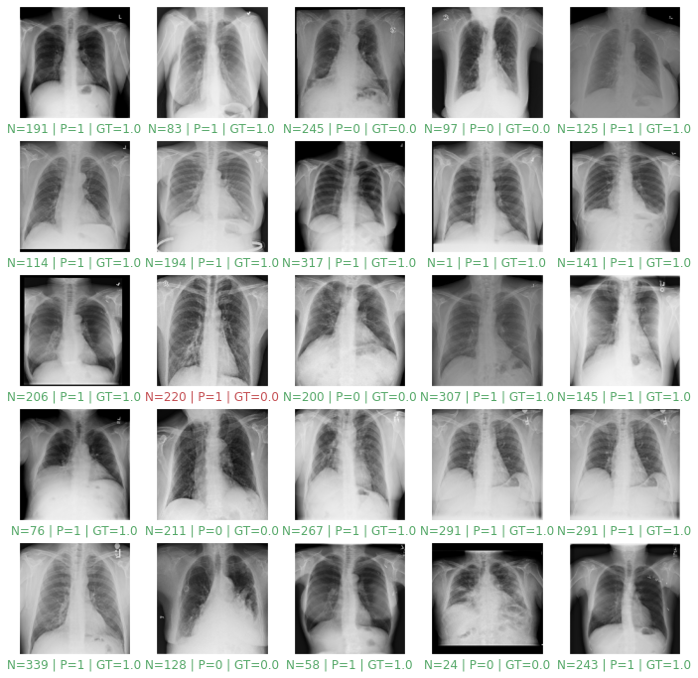
Below Figures shows the process of randomly detecting whether a person has Covid or not by feeding random 25 X-Ray testing images into the DenseNet201 and ResNet152 models.

Slide 21
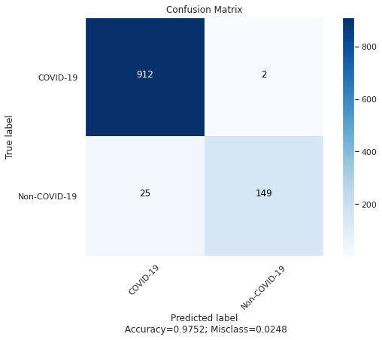
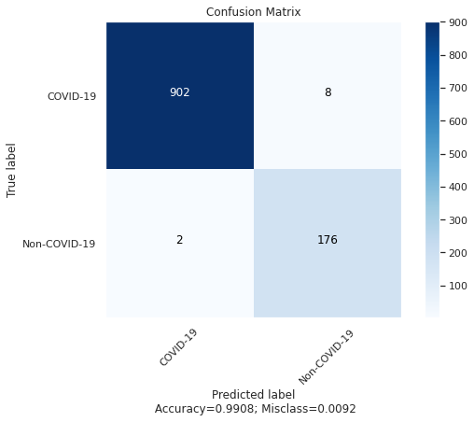
Below are the Confusion Matrices after applying DenseNet201 and ResNet152 models on CT-Scan Dataset.

Slide 22
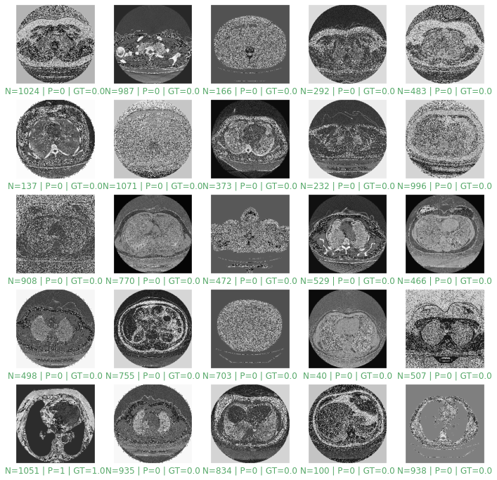
Below Figures shows the process of randomly detecting whether a person has Covid or not by feeding random 25 CT scan testing images into the DenseNet201 and ResNet152 models. .

Slide 23
Below are the performance metrics after applying DenseNet201 and ResNet152 models on X-Ray Dataset.
Metrics | DenseNet201 | ResNet152
MAE | 0.024816176470588234 | 0.009191176470588236
Accuracy | [0.97518382 0.97518382] | [0.99080882 0.99080882]
Precision | [0.9733191 0.98675497] | [0.99778761 0.95652174]
Recall | [0.99781182 0.85632184] | [0.99120879 0.98876404]
Specificity | [0.85632184 0.99781182] | [0.98876404 0.99120879]
Negative Predictive Value | [0.98675497 0.9733191 ] | [0.95652174 0.99778761]
Fall out | [0.14367816 0.00218818] | [0.01123596 0.00879121]
False Negative Rate | [0.00218818 0.14367816] | [0.00879121 0.01123596]
False Discovery Rate | [0.0266809 0.01324503] | [0.00221239 0.04347826]

Slide 24
Conclusion
After applying DenseNet201 and ResNet152 models, we noticed that ResNet152 performed more accurately on both datasets.
This approach is meant to make it easier for radiologists to examine patient lung pictures and lessen their diagnostic workload.
In our work we used Google colab pro platform for getting high computational units to execute our models.
A possible enhancement is to improve memory and computational efficiency and also by increasing the dataset and number of layers of respective models then there may be a chance of increase in performance.

Slide 25
THANK YOU

